Slide 1

A Proposal to Create an
Aquatic Invasive Species
Research Center
Peter W. Sorensen
Department of Fisheries, Wildlife & Conservation Biology
College of Food, Agriculture and Natural Resources Sciences
University of Minnesota, St. Paul MN 55108
soren003@umn.edu; 612-624-4997
Lessard-Sams Outdoor Heritage Council
January 26, 2012

Slide 2
OUTLINE
Definitions
The Problem
An Aquatic Invasive Species Research Center
6 Goals
Questions
Notes:
“foci” is too intellectual—can you substitute “goals” or “objectives”?

Slide 3
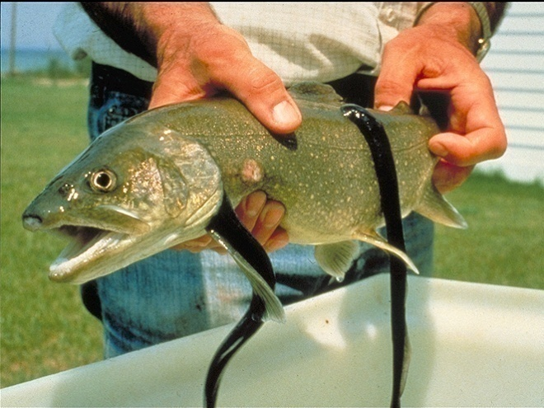
Invasive Species
an alien [nonnative / exotic / introduced] species whose introduction does or is likely to cause economic or environmental harm or harm to human health
(Executive Order 13112)

Slide 4
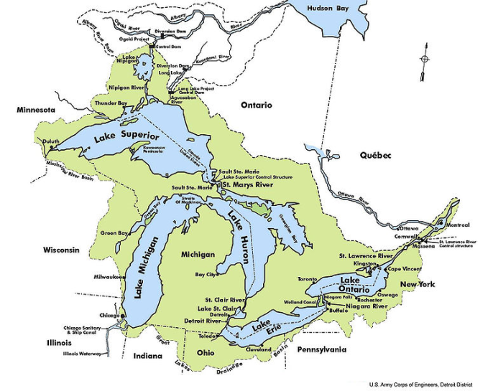
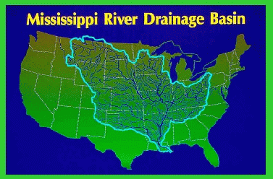
Aquatic Invasives: A huge threat to MN
Great Lakes Basin (180 species)
WHY?
- Inter-connectiveness
- Trade
Recreation
Mississippi River (140 species)
18 plants
3 microorganisms
4 crustaceans
5 molluscs
15 fishes
1 mammals

Slide 5
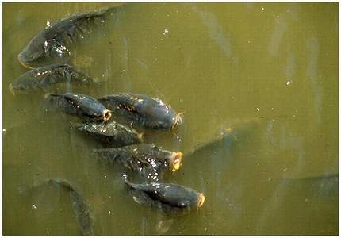
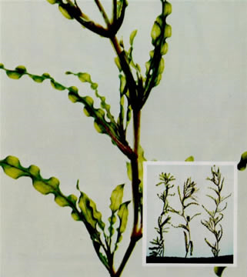
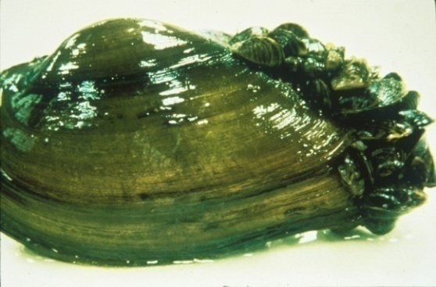
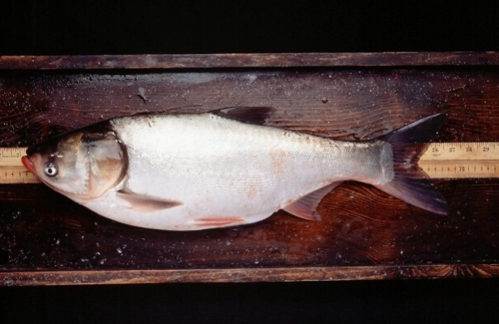
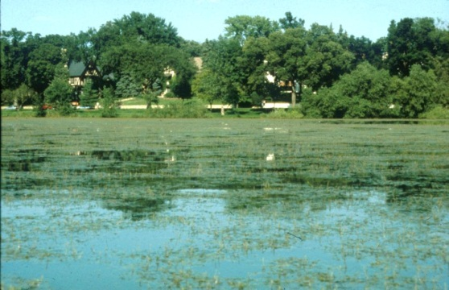
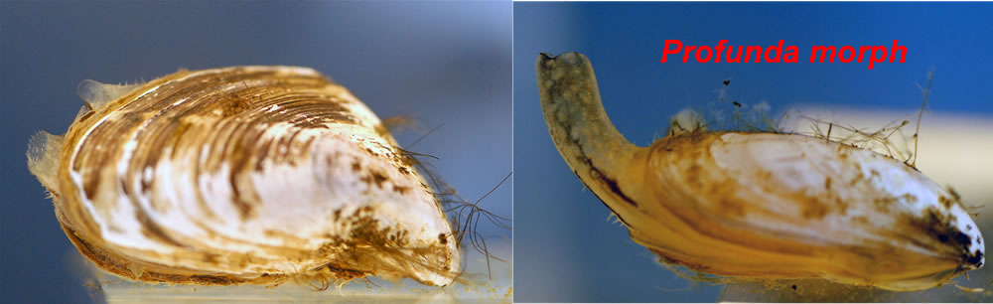
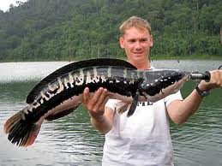
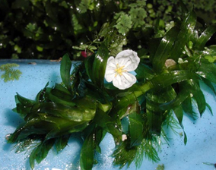
Invasive Species of Great Concern
?
?
?

Slide 6
Lessons from failed MN invasives control ‘experiments’
We can expect a continuous stream of invaders
  This is a war (not a battle—no time to lose)
These species are going to do a lot of damage
  The stakes are very high
These species are fundamentally different from native species
  Conventional approaches to control them do NOT work
Aquatic environments are especially difficult to work in
  You cannot even see what you are working with!

Slide 7

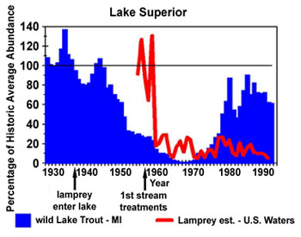
A SUCCESS: Control of the sea lamprey (Petromyzon marinus)

Slide 8
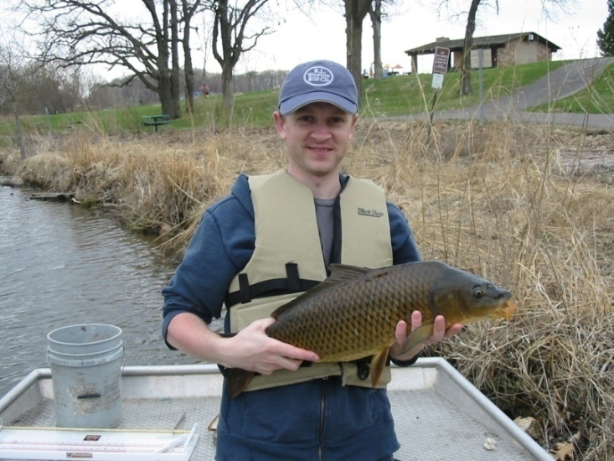
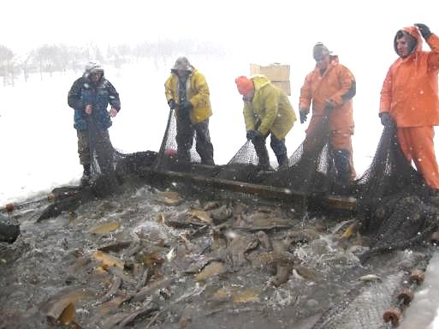
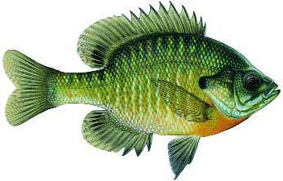

Another SUCCESS: Control of the common carp (Cyprinus carpio)

Slide 9
Lessons from successful control approaches
Conventional approaches simply do not work
Knowledge is empowering
Every species has its weakness
Need to find and target this weakness
Exotic species may have unexpected weaknesses

Slide 10
The way forward…
Prevent introduction
  …while seeking ways to delay invasion
Delay invasion
  …while seeking ways to reduce numbers
Reduce numbers
  …while seeking ways to manage
Control
  …while seeking ways to eradicate
Eradicate

Slide 11
Invasive Species Research Center
To develop new, permanent solutions to aquatic invasive species
The U’s research
center
DNR
Other Academic Federal Research
Watershed Districts
The Public
Control

Slide 12
Center Objectives
1. To develop new, reliable, and useful molecular monitoring programs
2. To develop new deterrence techniques
3. To develop new control techniques
4. To develop new eradication techniques
5. To develop statistically sound control strategies
6. To assist the DNR and others in the state with AIS

Slide 13
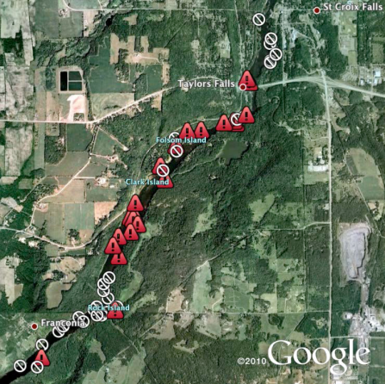
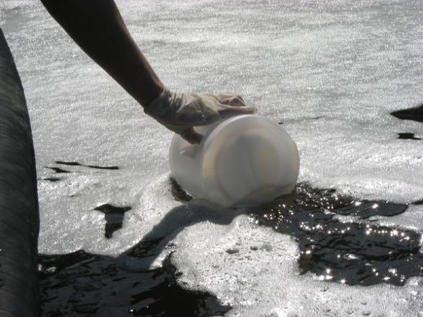
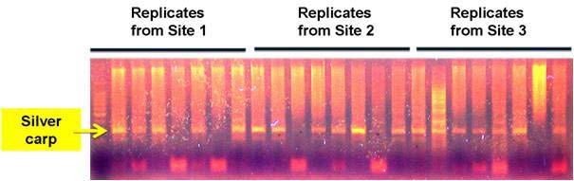
1. To develop new, reliable, and useful molecular tests and monitoring programs
Develop superior tests for species of immediate local concern
  Common carp, silver carp, zebra mussel
  eDNA, pheromones, other
Quickly validate these tests
Interpret these tests

Slide 14
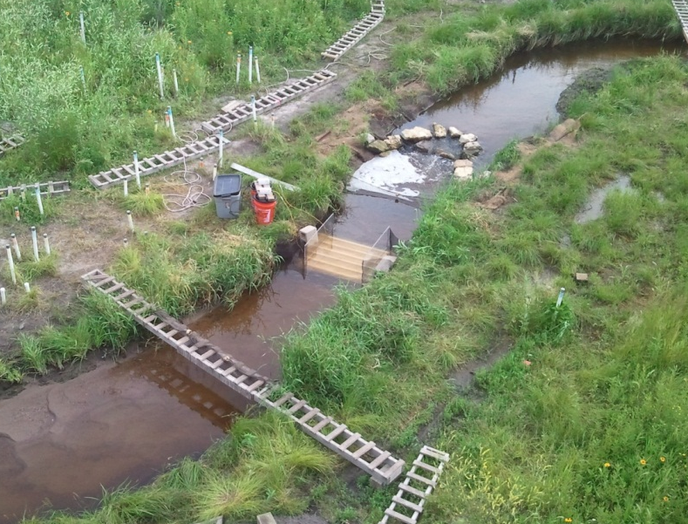
2. To develop new deterrence techniques
New, affordable barrier systems optimized for local species - Common carp, silver carp
- Bubble curtains, light, velocity w and w/o barrier
large rivers (ex. Minnesota River)
tributaries (ex. creeks leading into Minnesota)
Evaluate efficiency of these systems (SAFL)

Slide 15
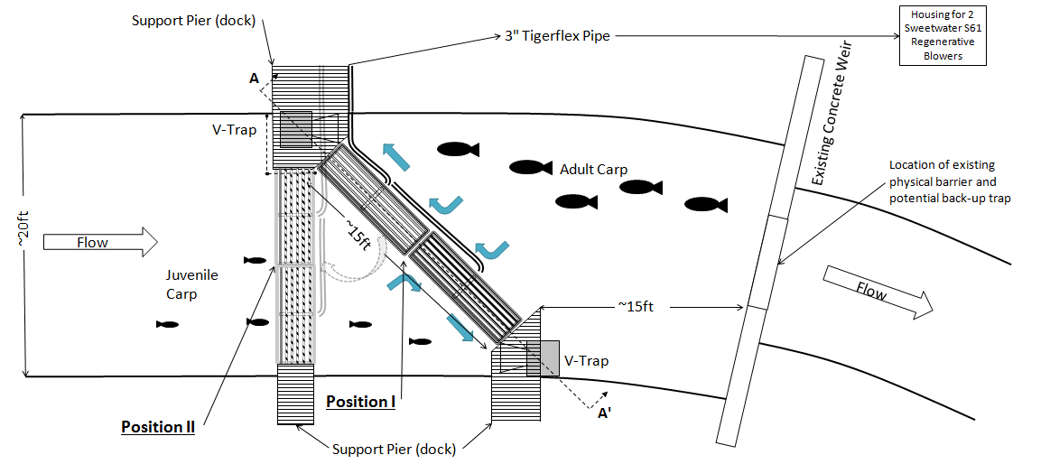
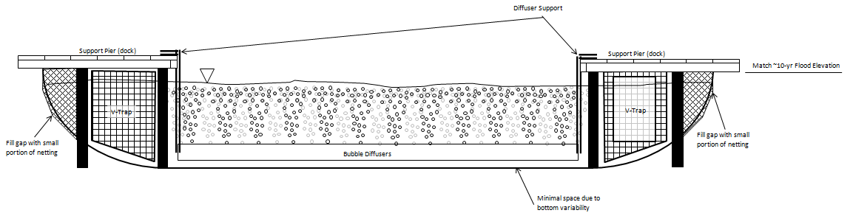
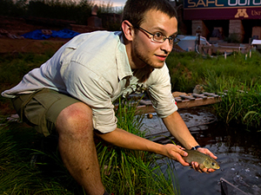
Experimental Air Barrier (Maplewood)

Slide 16
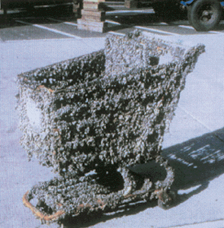
3. To develop new control techniques
3a. Zebra mussel physiology, biology and control
3b. Invasive fish ecology and control
3c. Invasive fish behavior and physiology
3d. Invasive plants

Slide 17
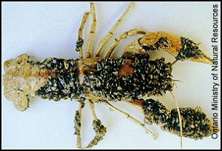
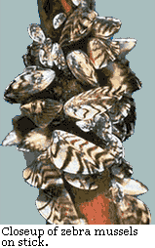
3a. Zebra mussel physiology, biology and control
Search for Achilles heel
New faculty expertise
Cutting-edge advice and help for DNR

Slide 18
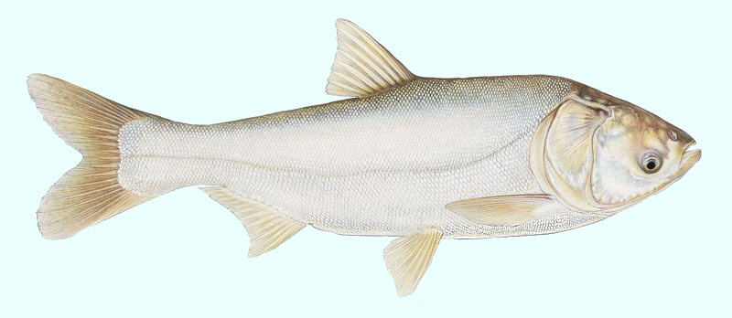
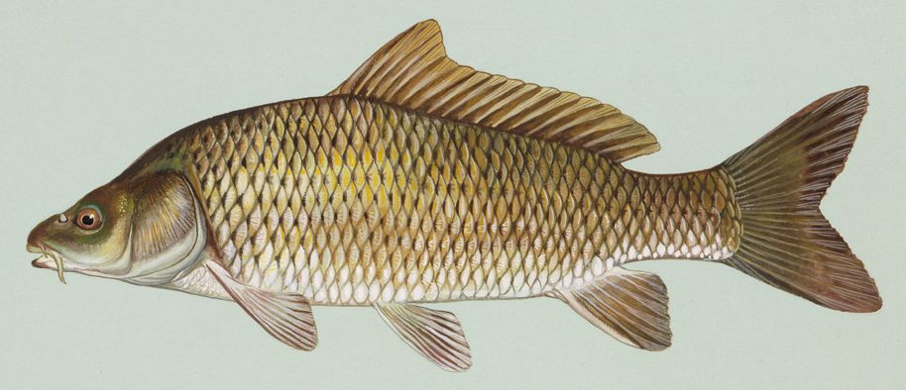
3b. Invasive fish ecology and control
Integrated pest management:
Search for natural controls for Asian carp
Further development/ application of common carp strategy
New faculty expertise
Expert advise and help for DNR, watershed districts, lake associations

Slide 19
3c. Invasive fish behavior, physiology and control
Integrated pest management:
Search for behavioral attracts and repellents for Asian and common carp
Judas fish and robotic tracking
Further development and application of common carp
Cutting-edge advise and help for DNR

Slide 20
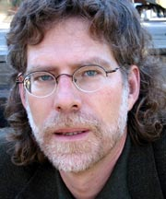
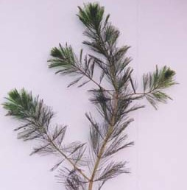
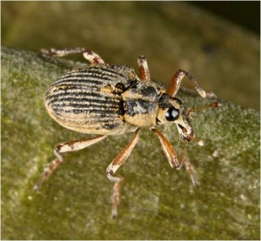
3d. Invasive plant control
Integrated Pest Management
Search for predators and control
Further development and application of IPM control plants
Cutting-edge advise and help for DNR
Eurasian Watermilfoil
Milfoil Weevil
(Euhrychiopsis lecontei)

Slide 21
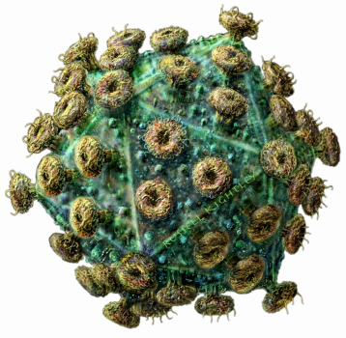
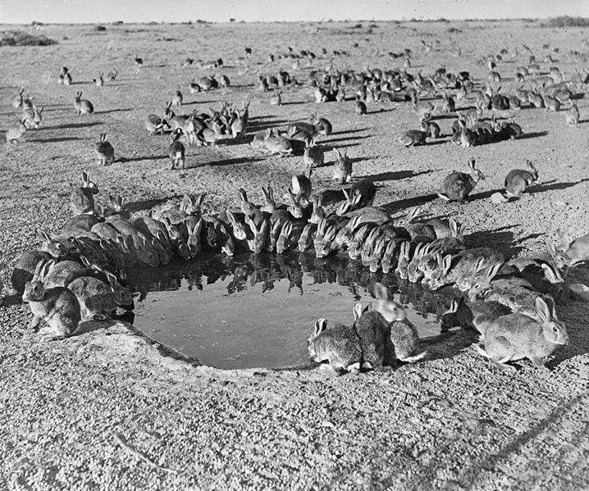
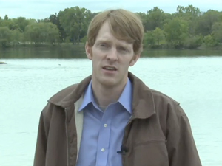
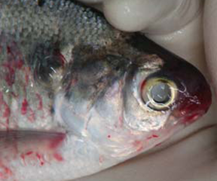
4. Develop eradication techniques
Search for species-specific viruses via international networks
New faculty and facility (Vet School)
Protection from exotic viruses
Expert advise and help for DNR

Slide 22
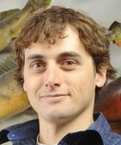
5. Perfect sampling and treatment protocols
Perfect application protocols through statistics
Expert advice and help for DNR

Slide 23

5. Information and technology transfer
New position and expertise
Transfer and testing of new expertise
Expert advise and help for watershed districts, lakeshore associations, DNR, etc.

Slide 24
Budget
Startup $2,000,000
(new labs, equipment and refurbishing)
Operations ($1,990,000/yr x 8)
Monitoring $294,000
Deterrence $258,000
Control $940,000
Eradication $290,000
Statistical guidance $77,000
Extension $129,000

Slide 25
Summary
Necessary
Cutting-edge science
Mult-faceted
Extension component
Complimentary to the DNR
Flexible for the future

Slide 26
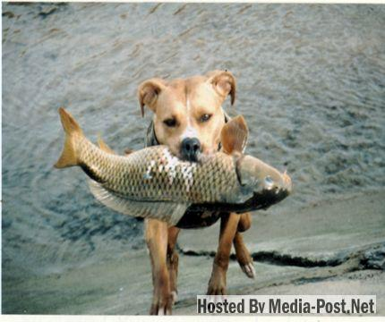
Questions?

